Slide 1

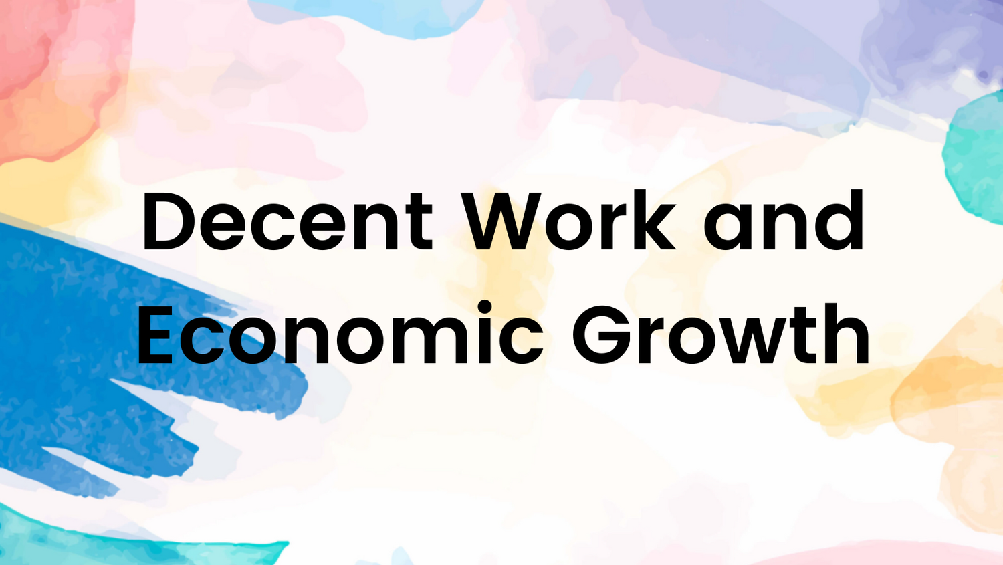
Achieving SDG 8: Addressing Unemployment for Inclusive Growth
Data Analysis IBM Internship 2024-25

Slide 2
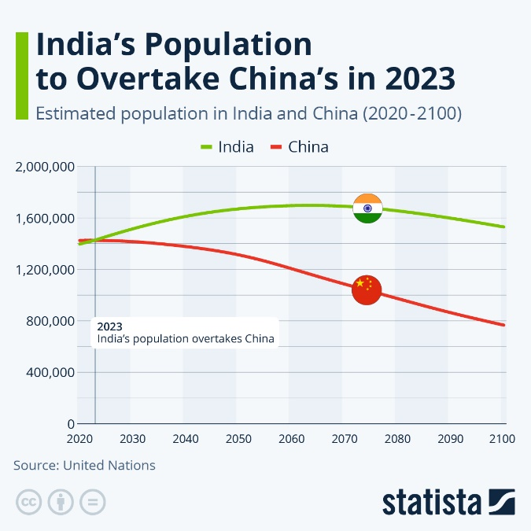
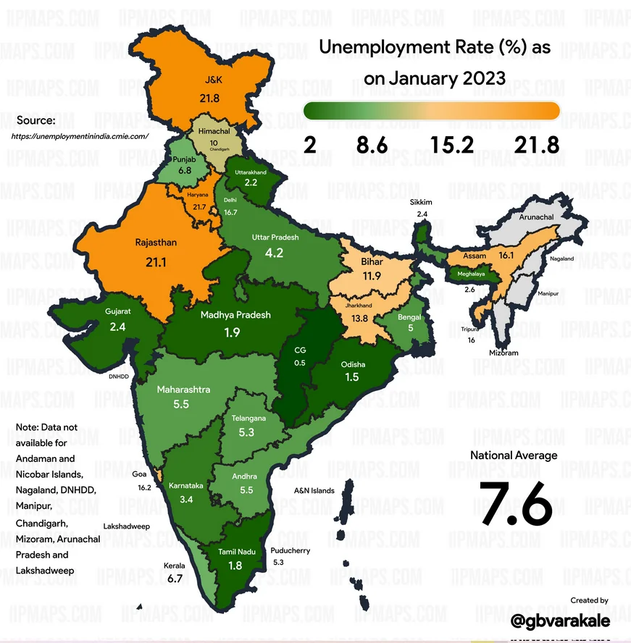
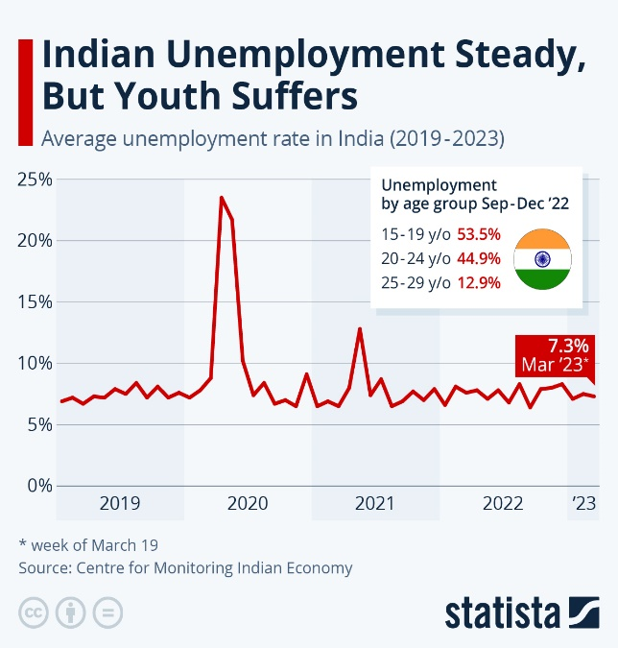

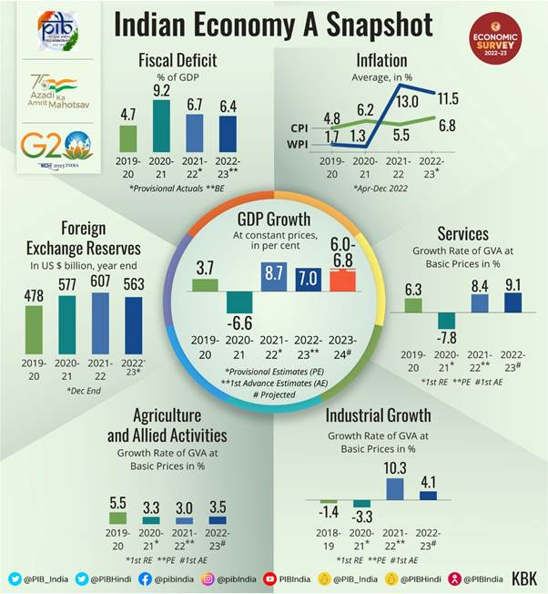
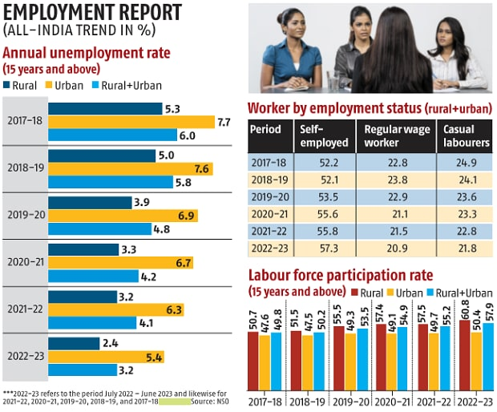
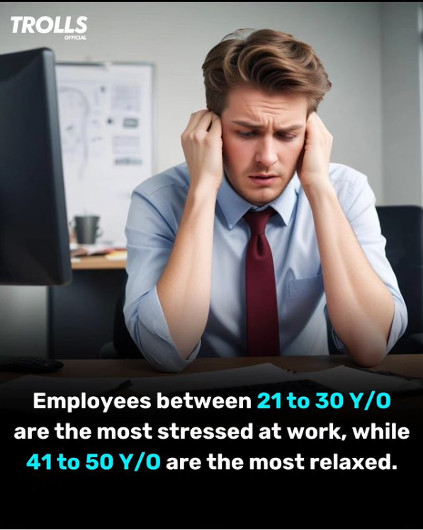
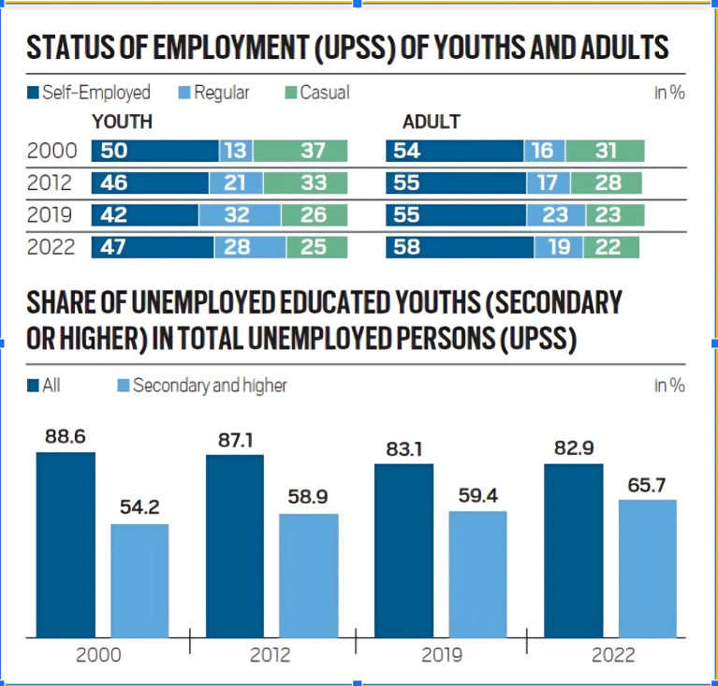
From Numbers to Notions: Analyzing Year-wise Unemployment in India

Slide 3

TEAM MEMBERS
Ujwala Bhashkar Ramteke (Team Lead)
Tofiqahemad Sheikh
Chetan Dattatraya Lengare
Chaitrali Mukund Gaikwad
Shahid Saber Baig
Ajit Vilas Bhosale

Slide 4
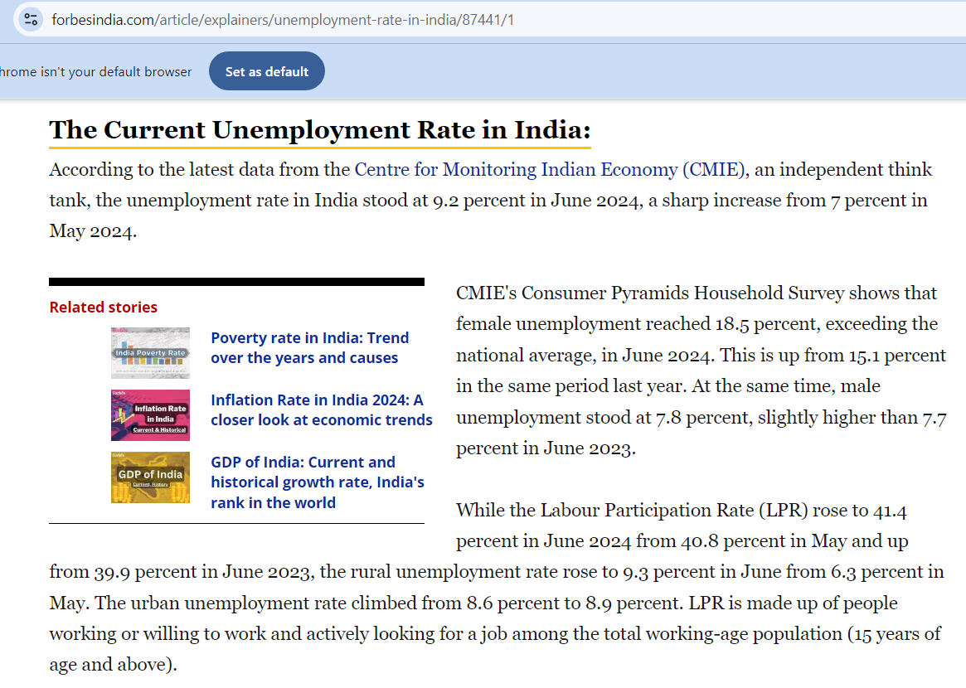
Introduction
Unemployment refers to the condition where individuals who are capable and willing to work cannot find a job.
High unemployment causes the economy to stagnate, consumer spending to decline, and industry growth to be poor.
Poverty and inequality are made worse by this, which impedes the achievement of important Sustainable Development Goals, especially SDG 1 (No Poverty) and SDG 8 (Decent Work and Economic Growth).
Furthermore, the country's GDP potential is hampered by the inadequate utilization of the labor force, which restricts economic growth and affects initiatives for long-term sustainability and development.
https://www.forbesindia.com/article/explainers/unemployment-rate-in-india/87441/1

Slide 5
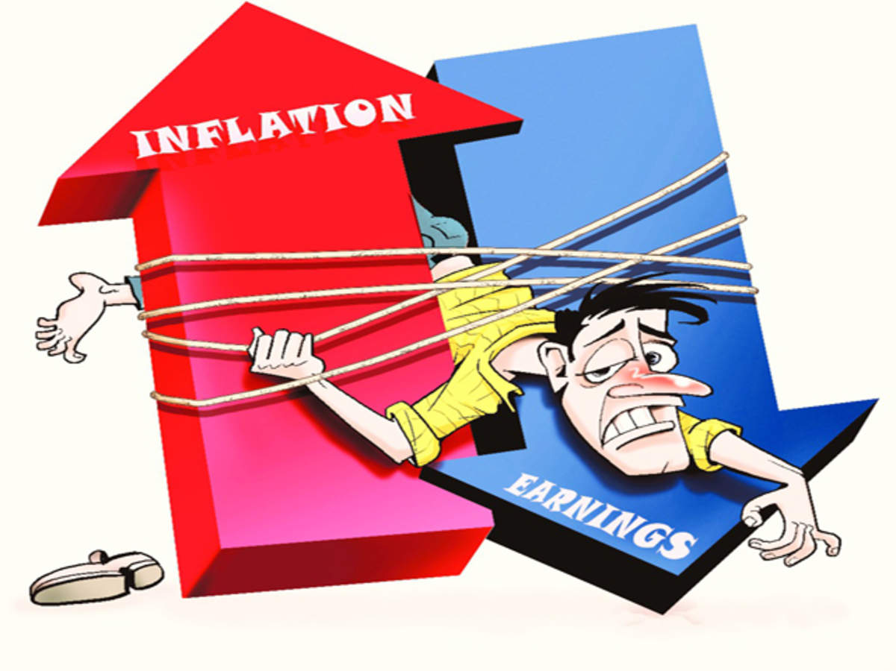

Project Summary
In India, Unemployment is still a major problem that threatens both social cohesion and sustained economic progress.
At 42% among graduates under 25, youth unemployment in India is a serious obstacle to attaining SDG 8, which calls for equitable, sustained economic growth and decent work for all.
In 2023, the economy expanded by 7.3%, but there was still a shortage of jobs because of structural problems, a poor response from the private sector, and dishonest tactics like phony job postings. These elements restrict sustainable development and weaken confidence in the labour market.
To address this and ensure that economic growth translates into real employment possibilities, it is necessary to implement comprehensive policies, ethical recruitment procedures, and concentrate on industries that are capable of accepting young workers.
Another major issue facing the world today is inflation, which raises operating expenses and lowers consumer purchasing power, resulting in job losses.
Business investments are hampered by rising interest rates and economic uncertainty, and job losses are made worse by profit margin pressures and the wage-price spiral, underscoring the necessity of targeted government measures.

Slide 6

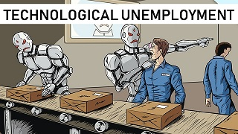
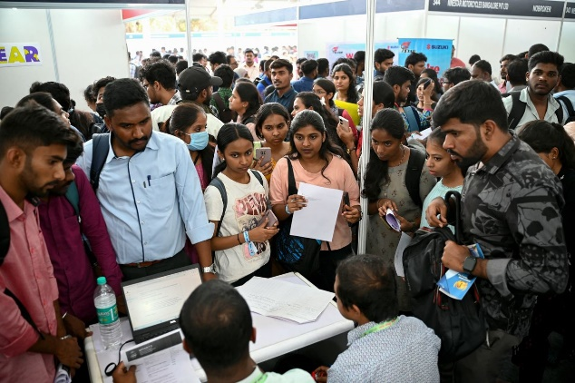
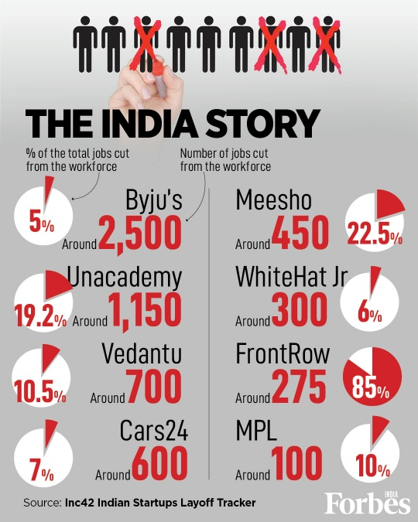
Purpose of the Project
The purpose of this project is to support SDG 8 by analyzing unemployment data to identify key areas of deficit across technology, gender, industry, and state, and to propose data-driven solutions for achieving full and productive employment and sustained, inclusive economic growth.

Slide 7
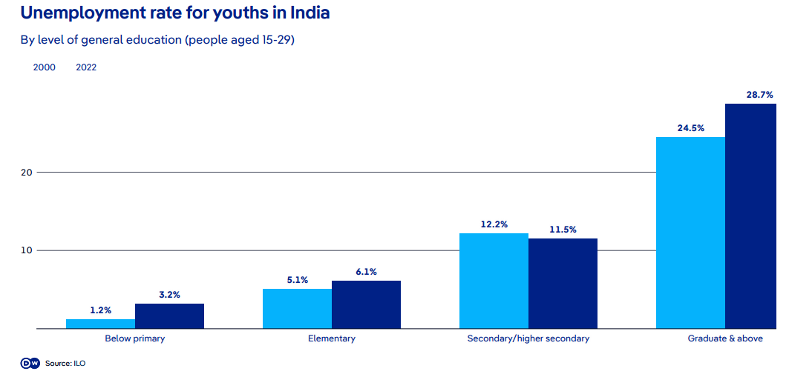
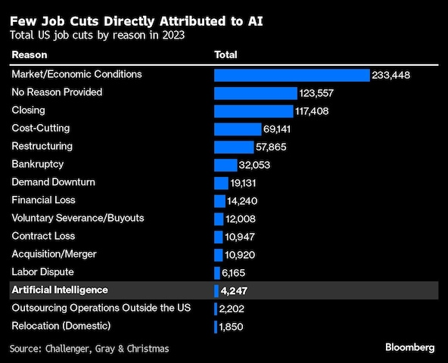
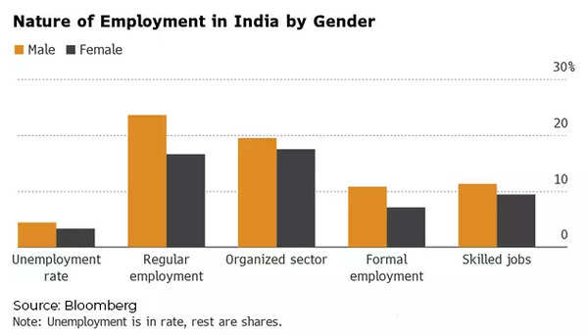
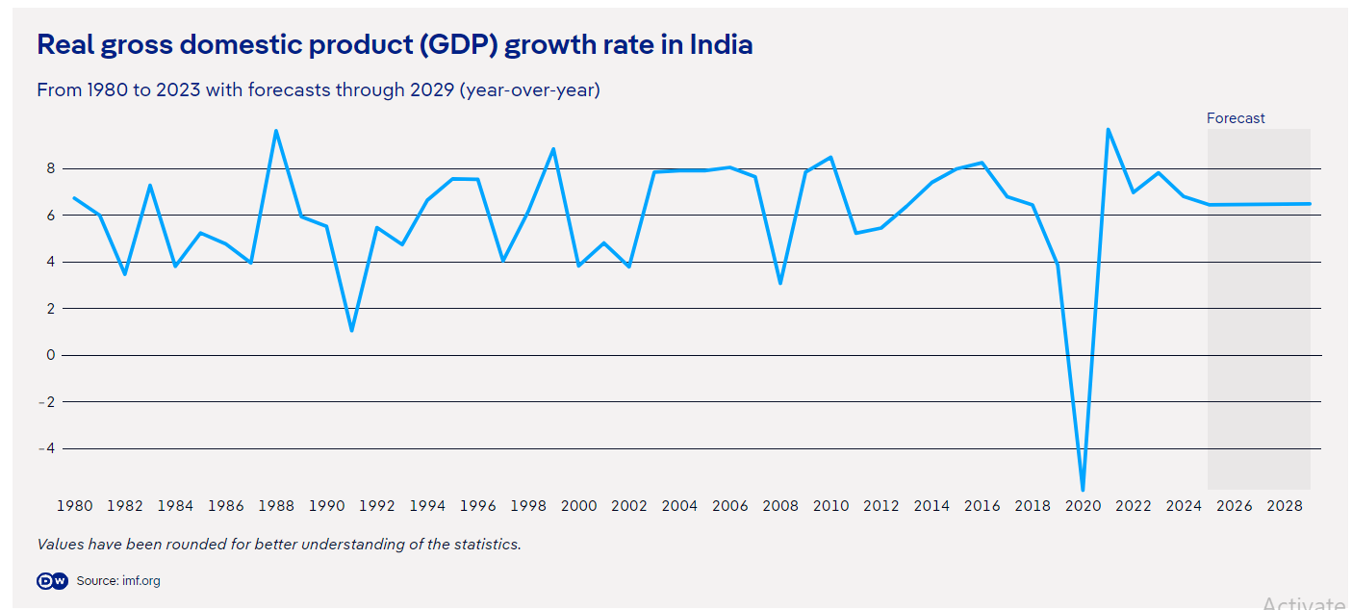
Points that need to be focus
What's behind high joblessness among India's youth?
https://www.indiatoday.in/technology/news/story/ai-and-cost-cutting-biggest-reasons-why-tech-lays-offs-have-surged-by-136-per-cent-in-2024-reveals-study-2499830-2024-02-09
Young Indians more likely to be jobless if they’re educated - Times of India (indiatimes.com)
https://www.dw.com/en/india-high-youth-unemployment-poses-massive-challenge/a-69018952#:~:text=youth%20unemployment%20rate.-,Nearly%2016%25%20of%20urban%20youth%20in%20the%2015%2D29%20age,at%20as%20high%20as%2045.4%25.
https://www.livemint.com/news/india/unemployment-crisis-83-of-jobless-indians-are-youth-says-international-labour-organisation-report-11711517084127.html
https://www.livemint.com/news/find-out-why-educated-young-indians-are-most-likely-to-be-jobless-report-11711764936505.html

Slide 8
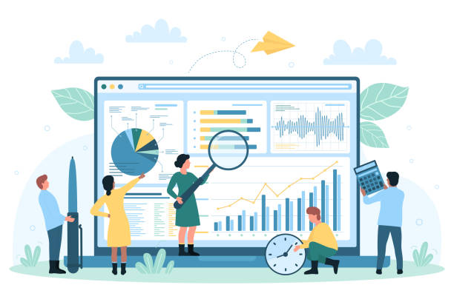
Data Loading & Cleaning Process
Import Libraries
Load Dataset
Exploratory Data Analysis
Handling missing values
Remove duplicates
Fix data types

Slide 9
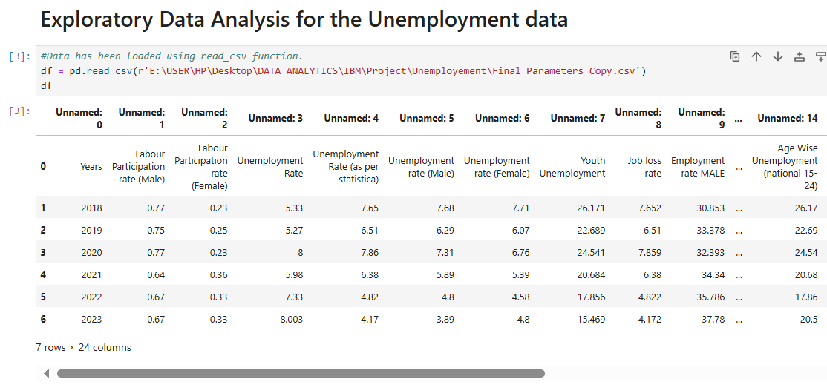
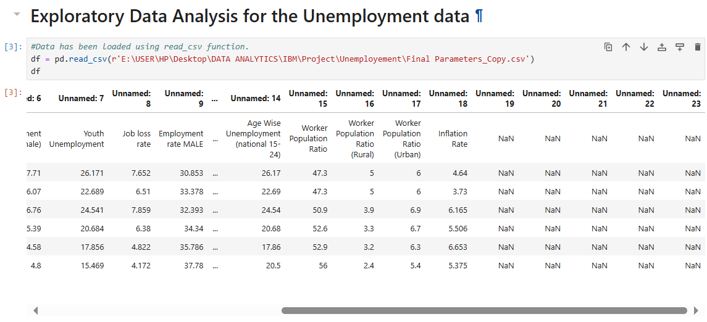
Sources of Data Used
Sources:
Kaggle: http://www.kaggle.com
Government website:
https://data.gov/ , https://www.mospi.gov.in/
ILOSTAT: https://ilostat.ilo.org/
Directorate General of Employment: https://dge.gov.in/dge/

Slide 10
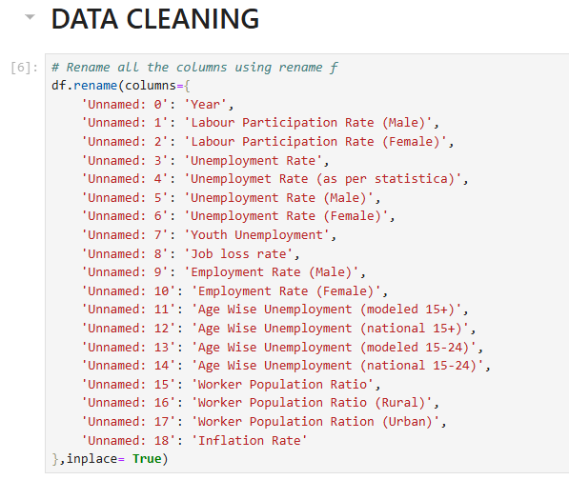
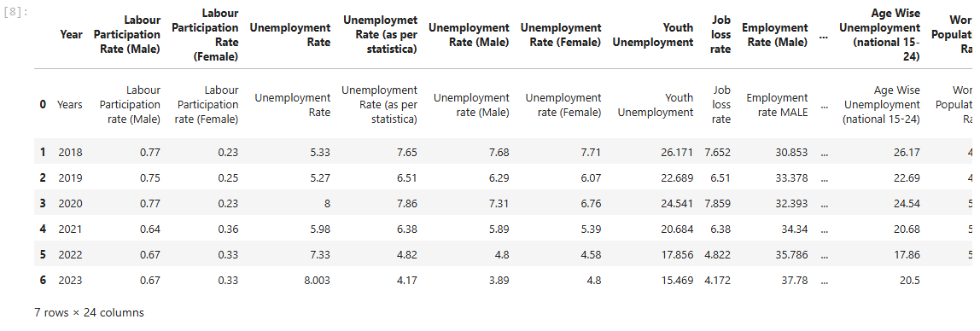
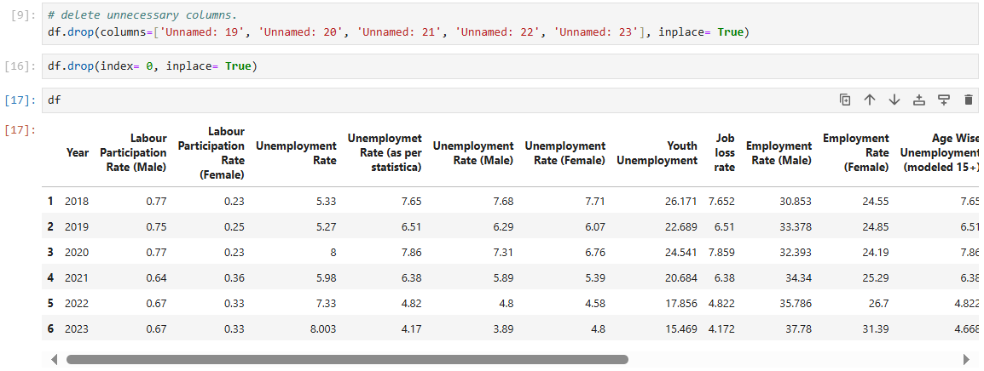
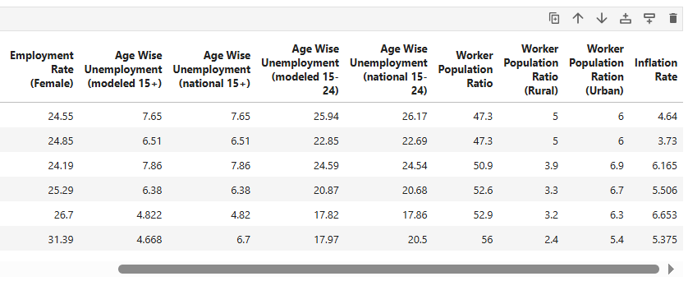
Data Cleaning & Exploratory Data Analysis

Slide 11
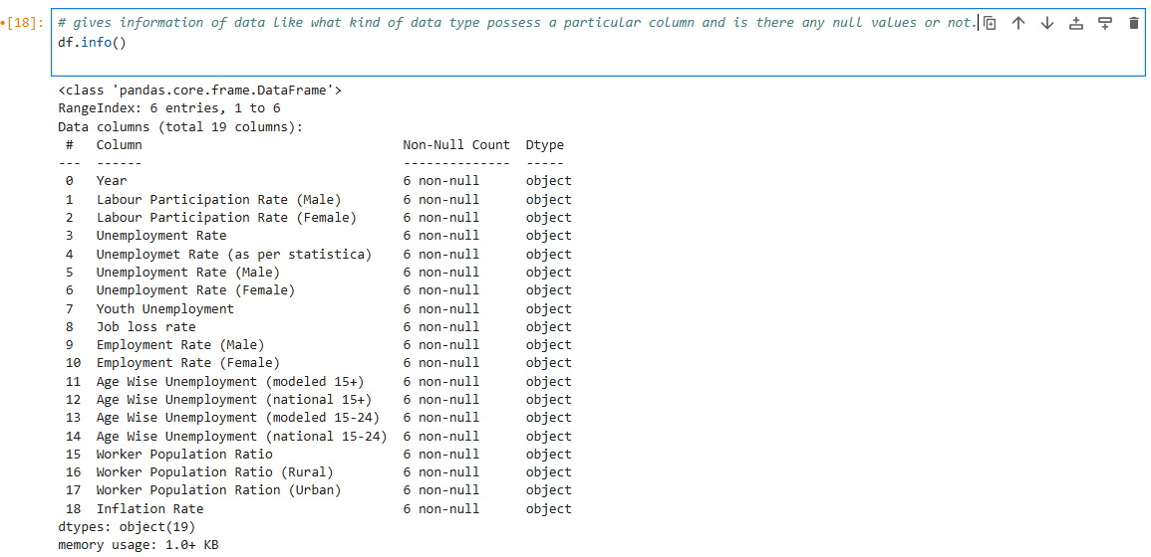
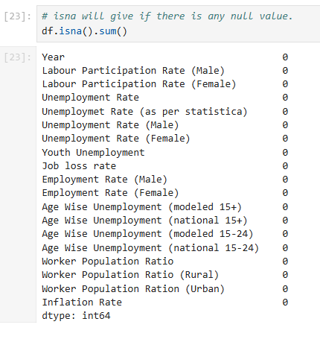
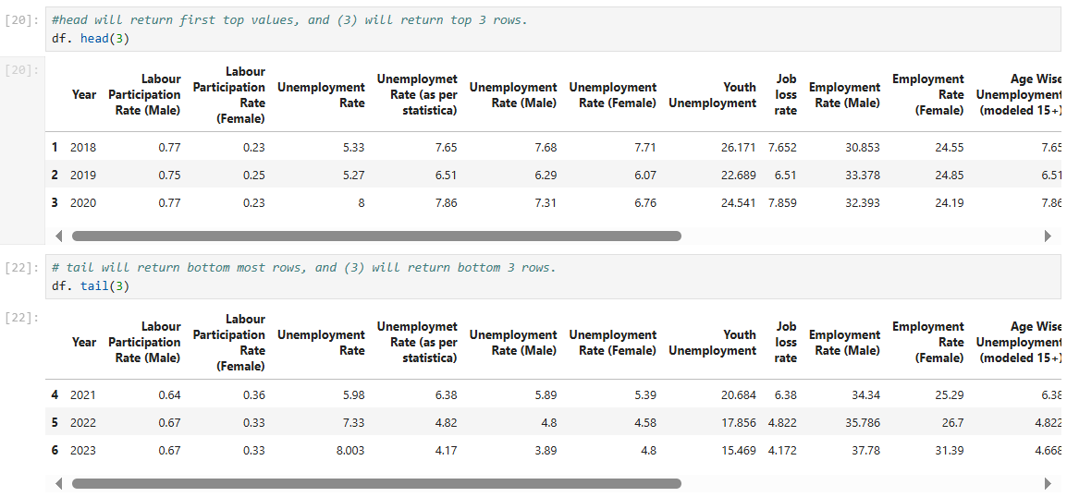
Data Cleaning & Exploratory Data Analysis

Slide 12
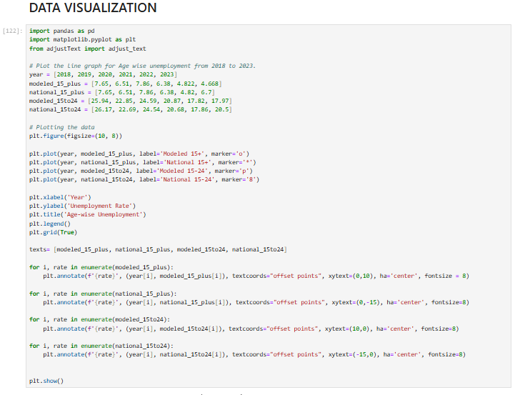
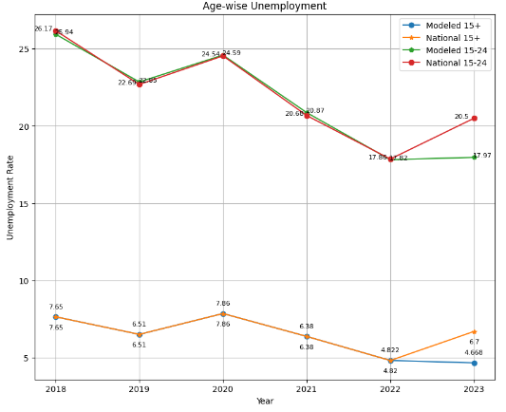
Data Visualization
Fig 1: Line Plot showing Age wise Unemployment
Modeled age groups: are categories created using statistical models.
National age groups: refer to the segmentation of the labour force based on age categories as reported directly by National Statistivcal Agencies.

Slide 13
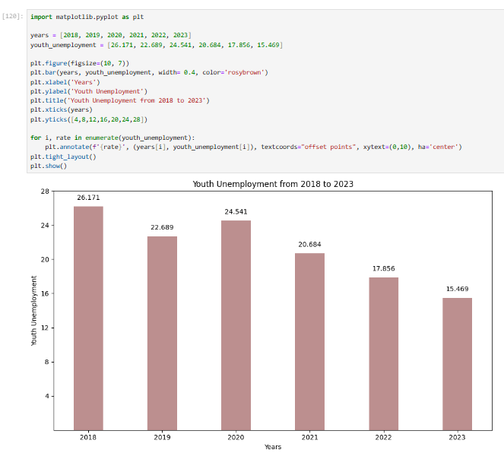
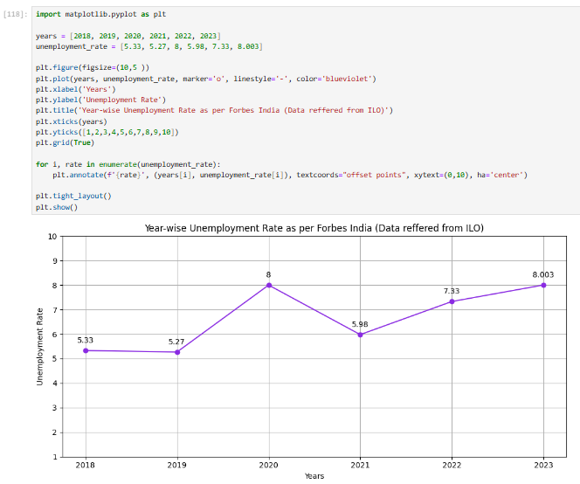
Data Visualization
Fig 2: Bar plot showing Youth Unemployment
Fig 3: Line graph showing Year-wise Unemployment as per ILO

Slide 14
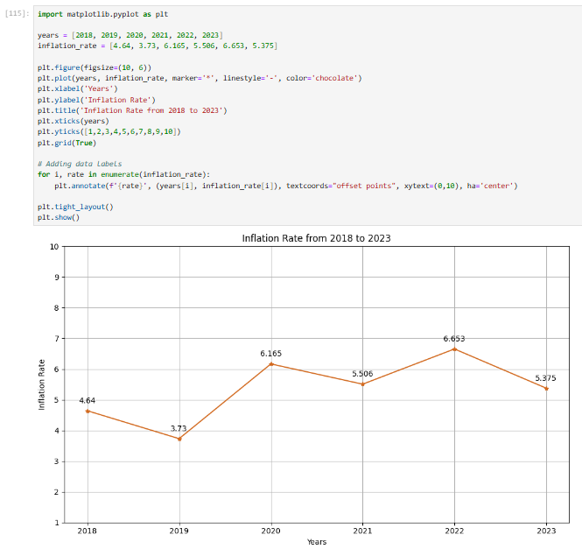
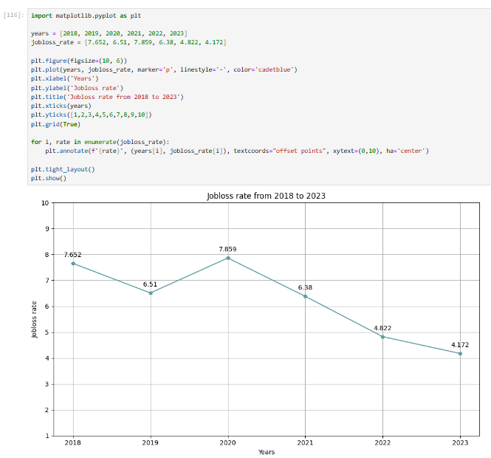
Data Visualization
Fig 4: Line plot showing Inflation Rate
Fig 5: Line plot showing Job loss Rate

Slide 15
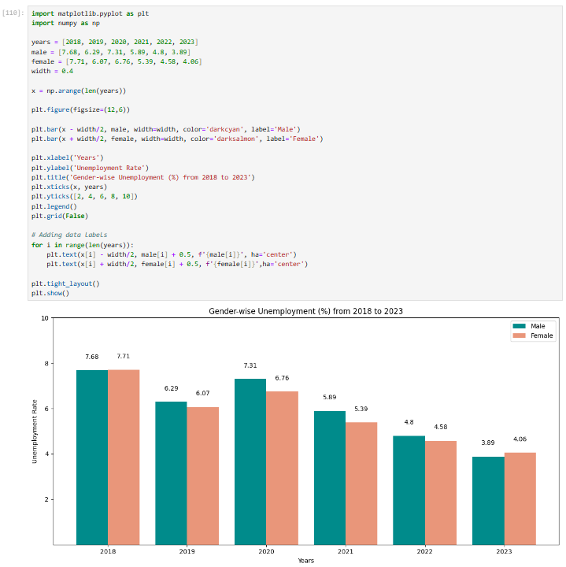
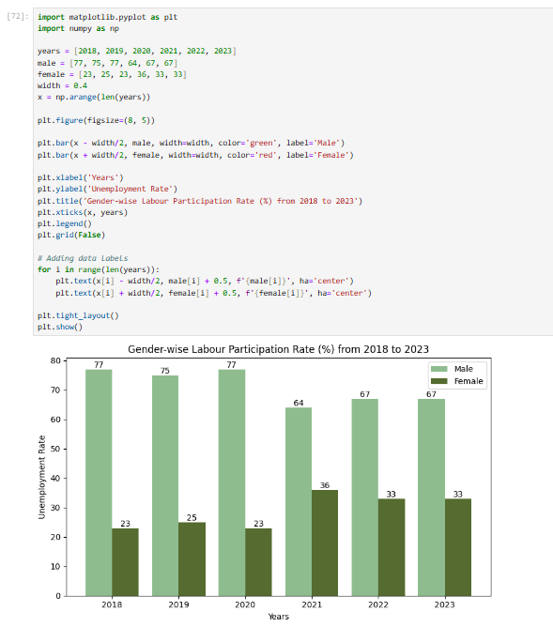
Data Visualization
Fig 6: Bar plot showing Gender wise Unemployment Rate
Fig 7: Bar plot showing Gender wise Labour Participation Rate

Slide 16
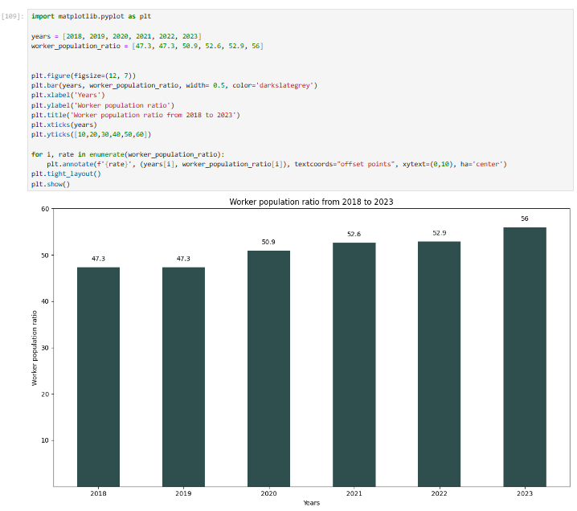
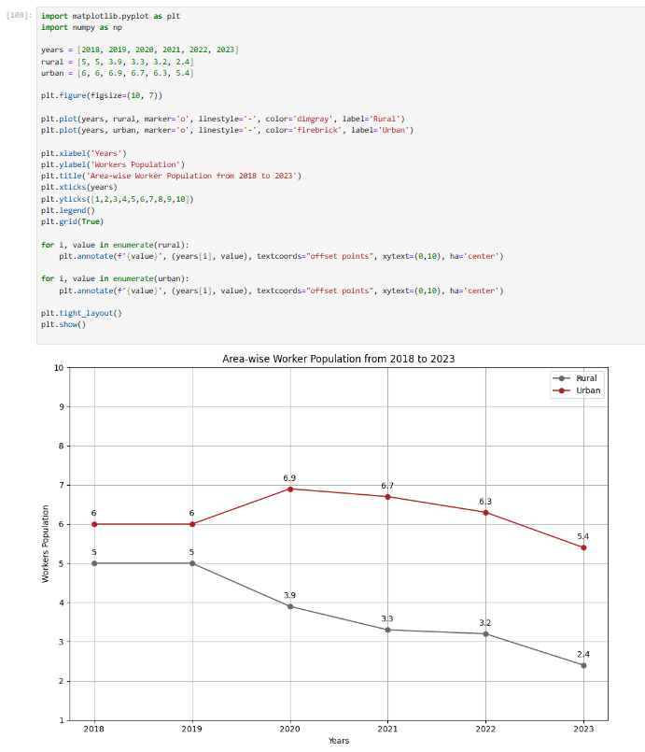
Data Visualization
Fig 8: Bar plot showing Worker population ratio
Fig 9: Line plot showing Area wise Worker population

Slide 17
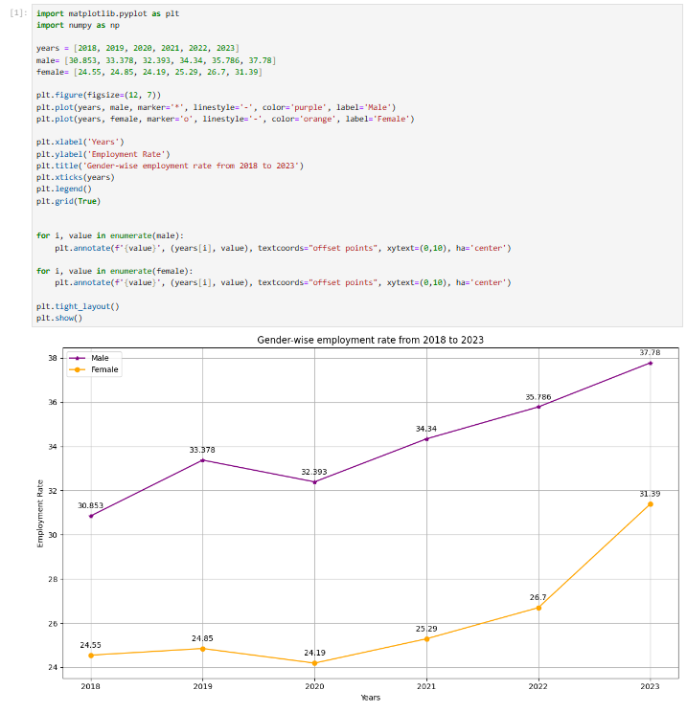
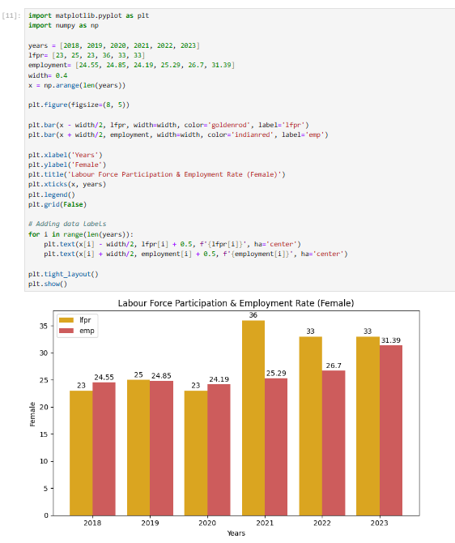
Data Visualization
Fig 10: Line plot showing Gender-wise Employment rate
Fig 11: Bar plot showing LFPR & Employment rate (Female)

Slide 18
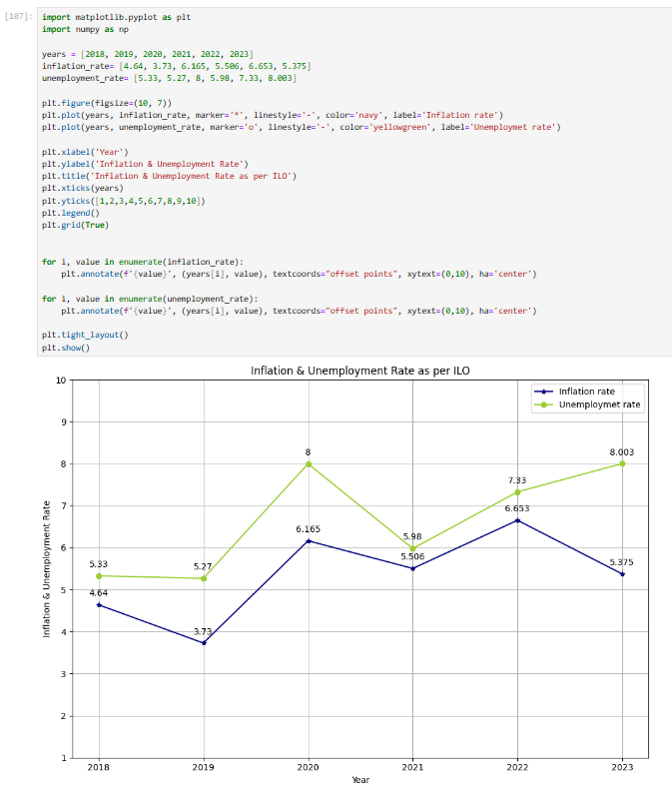
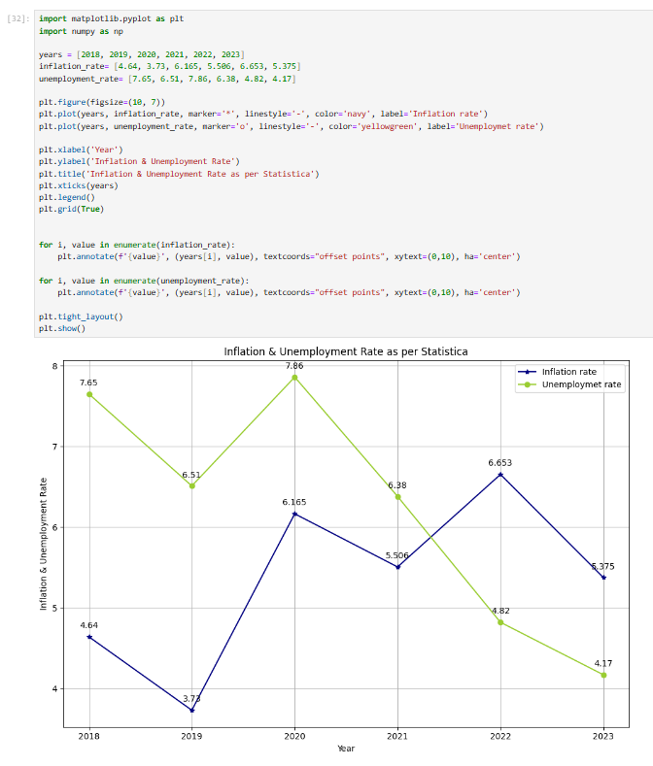
Data Visualization
Fig 12: Line plot showing Inflation & Unemployment rate as per ISO
Fig 13: Line plot showing Inflation & Unemployment rate as per STATISTICA

Slide 19
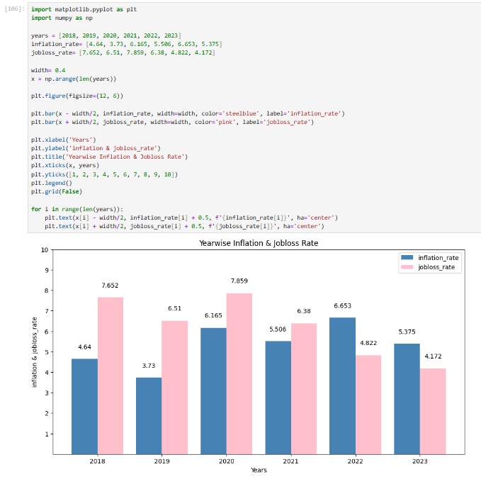
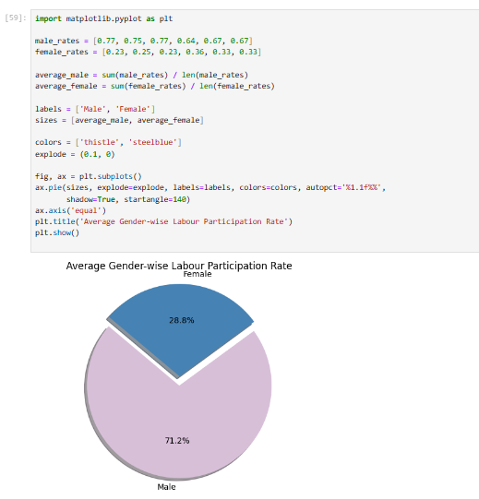
Data Visualization
Fig 14: Bar plot showing Year-wise inflation & Job loss Rate
Fig 15: Pie plot showing Gender-wise LFPR

Slide 20
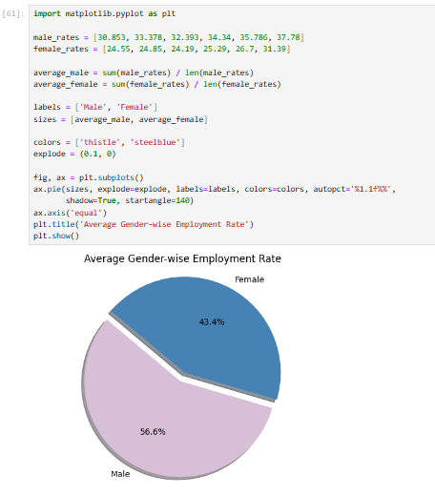
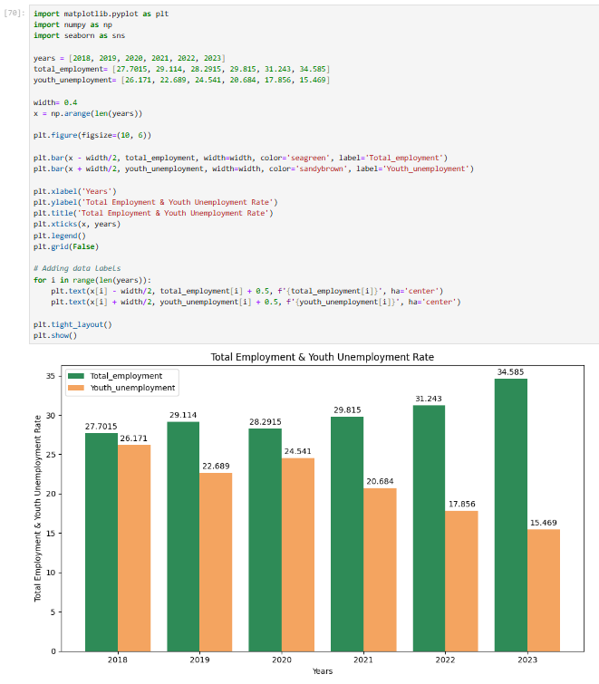
Data Visualization
Fig 16: Pie plot showing Average Gender-wise Employment Rate
Fig 17: Bar plot showing Total & Youth Unemployment Rate

Slide 21
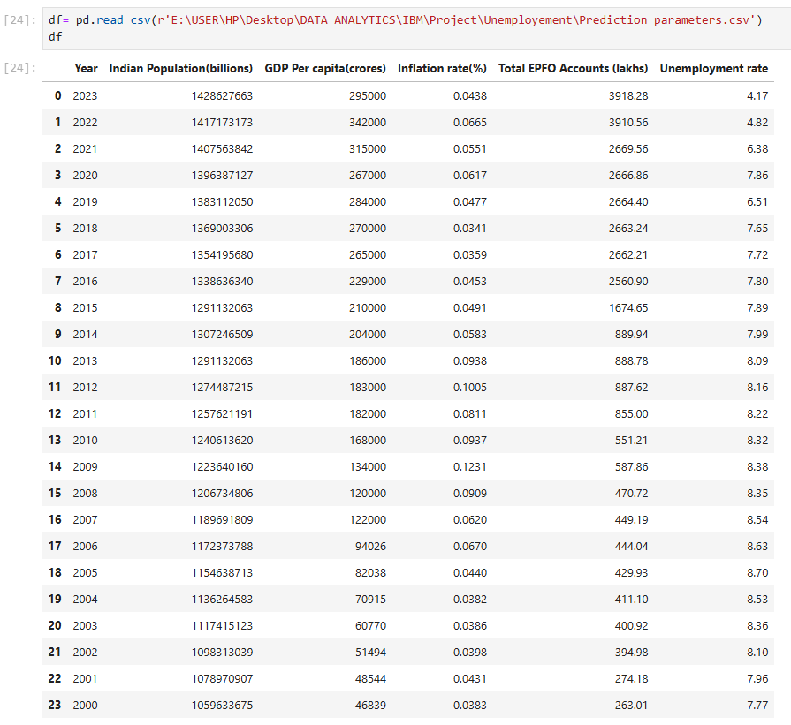
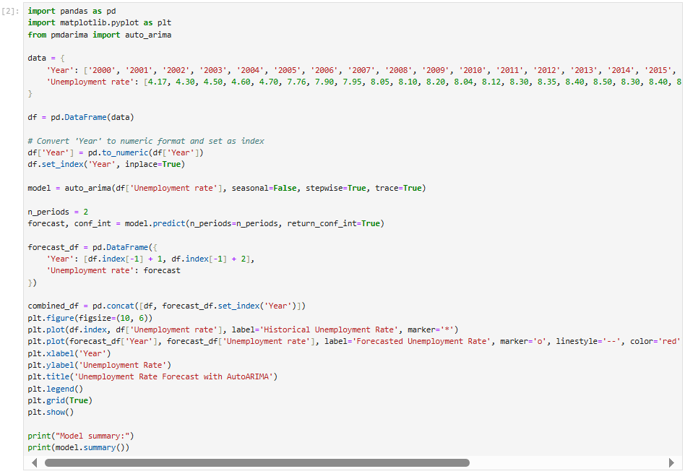
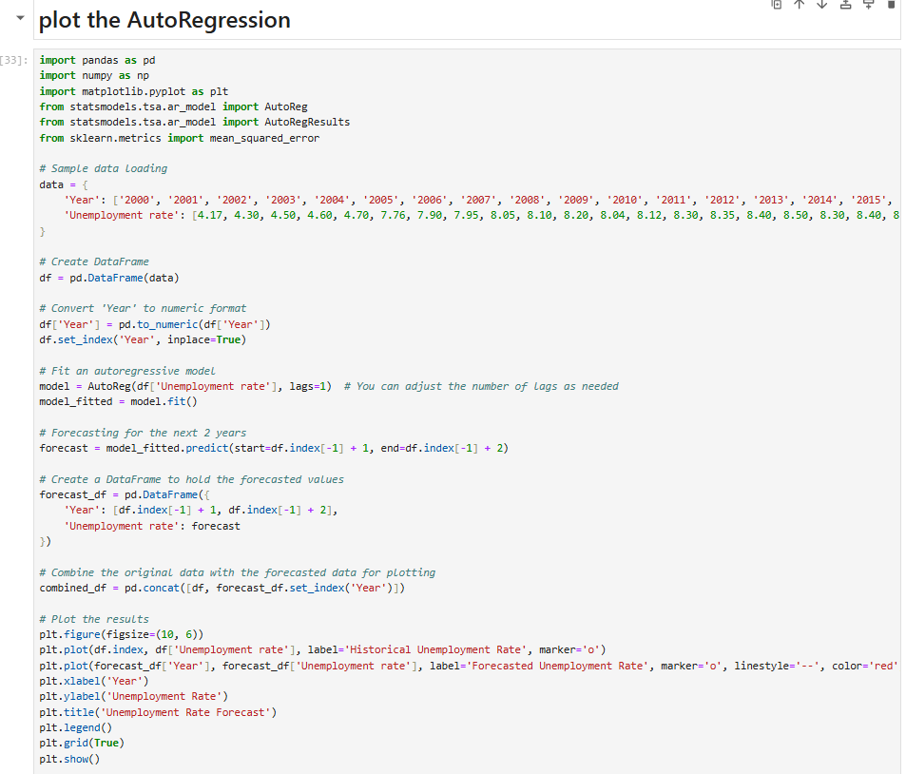
Projected Unemployment Rate for 2024 and 2025

Slide 22
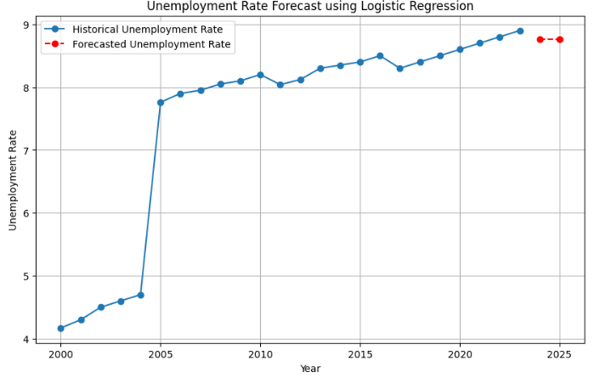
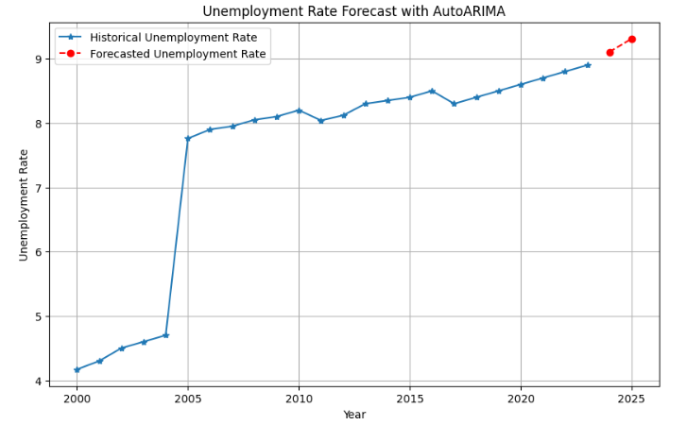
Projected Unemployment Rate for 2024 and 2025
Fig 18: Line graph showing projected unemployment rate for the year 2024 and 2025 using Logistic Regression
Fig 19: Line graph showing projected unemployment rate for the year 2024 and 2025 using AutoARIMA

Slide 23
Insights
Overall Unemployment:
From 2018 to 2023, overall unemployment rates have decreased, with youth unemployment falling from 26.171% to 15.469%. However, the 15-24 age group continues to experience higher unemployment rates compared to the broader 15+ age group.
2. Covid19 Impact:
The unemployment rate peaked in 2020 due to the COVID-19 pandemic but recovered through 2022 and 2023, while inflation rates remained lower post-COVID, indicating successful economic stabilization efforts.
Job loss and Employment rates:
Post-pandemic recovery strategies have effectively reduced the job loss rate below pre-COVID levels, with total employment rising significantly from 27.7015% in 2018 to 34.585% in 2023.
4. Gender Disparity:
Before and after COVID-19 until 2022, male unemployment rates were higher than female rates, but in 2023, male unemployment decreased while female rates increased. Despite a high female employment rate of 43.4%, the low female labor participation rate of 28.8% compared to 71.2% for males highlights a significant gender disparity.
5. Urban vs. Rural Employment:
Before COVID-19, the worker population ratio in rural areas was decreasing, while in urban areas, it increased in 2020 but has been gradually decreasing since then.
6. Forecast for 2024 & 2025: The graph shows a sharp rise in unemployment from 2000 to 2005, stabilization until 2023, and an increase in 2024-2025. Forecasts project unemployment rates slightly below 9%, indicating a continuing upward trend.

Slide 24


Conclusion
Overall, the data suggests a positive recovery post-COVID in terms of economic growth, yet it also highlights persistent issues with youth unemployment. This issue is widely discussed in articles and news, reflecting that today's youth face significant challenges due to cost-cutting, AI advancements, skill mismatches, and economic conditions. These factors contribute to struggles not only financially but also mentally.
The graph shows historical and forecasted unemployment rates using AutoARIMA, with a sharp rise from 2000 to 2005, stabilizing around 2008, fluctuating slightly until 2023, and increasing for 2024-2025. Logistic regression projects rates slightly below 9%, indicating a continuing upward trend.
While EPFO enrollment data provides valuable insights into employment rates, it may not fully capture the complexity of the employment landscape. The data, though not entirely incorrect, can be somewhat misleading and requires stricter improvements for accuracy. Incorporating more detailed analyses, such as gender-wise, age-wise, and industry-specific unemployment rates, would offer a clearer and more comprehensive picture.
Addressing these issues through targeted interventions, such as closing skill gaps, supporting mental health, and providing career development resources, is crucial. This will help mitigate the broader impacts of unemployment and contribute to a more inclusive and resilient job market.

